Slide 1
INTERNSHIP STUDIO
ETHICAL HACKING – TASK 2

Slide 2
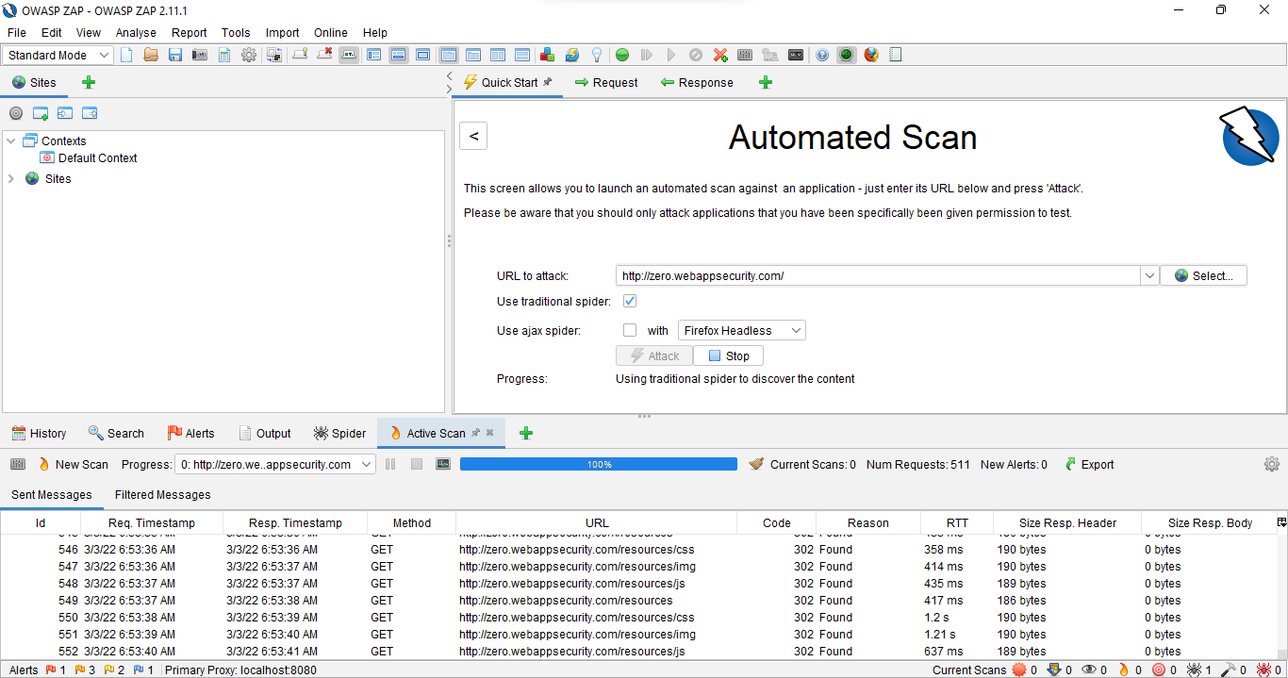
OWASP ZAP SCAN

Slide 3
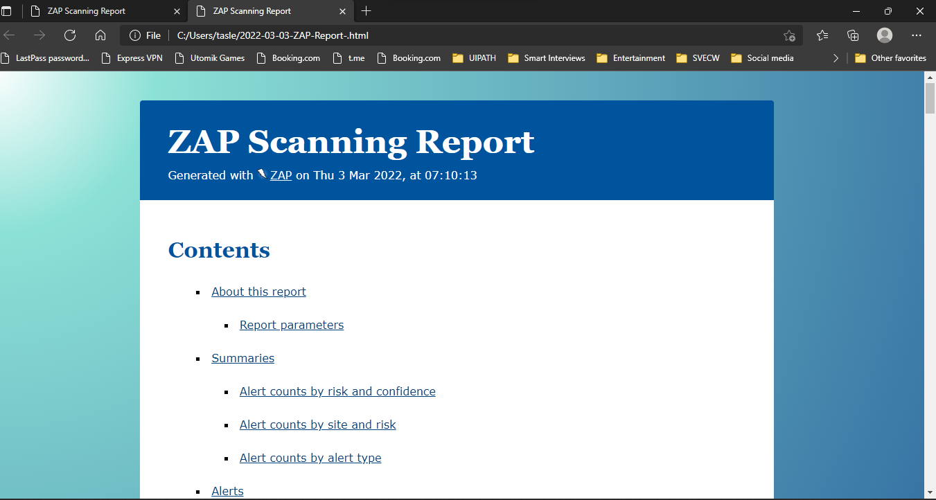
SCREEN SHOTS OF THE REPORT:

Slide 4
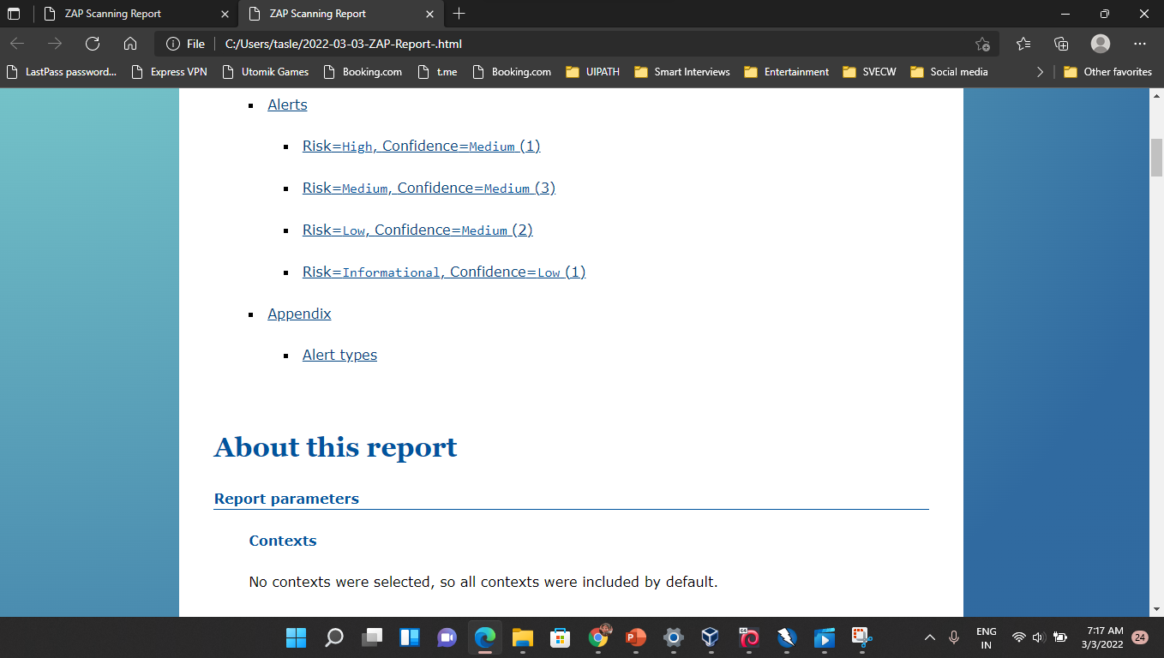

Slide 5
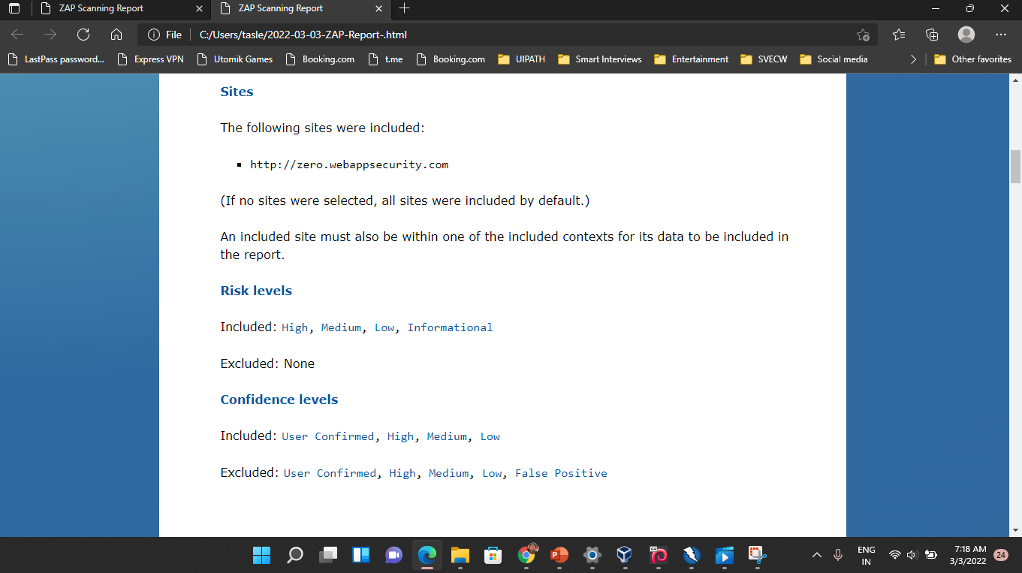

Slide 6
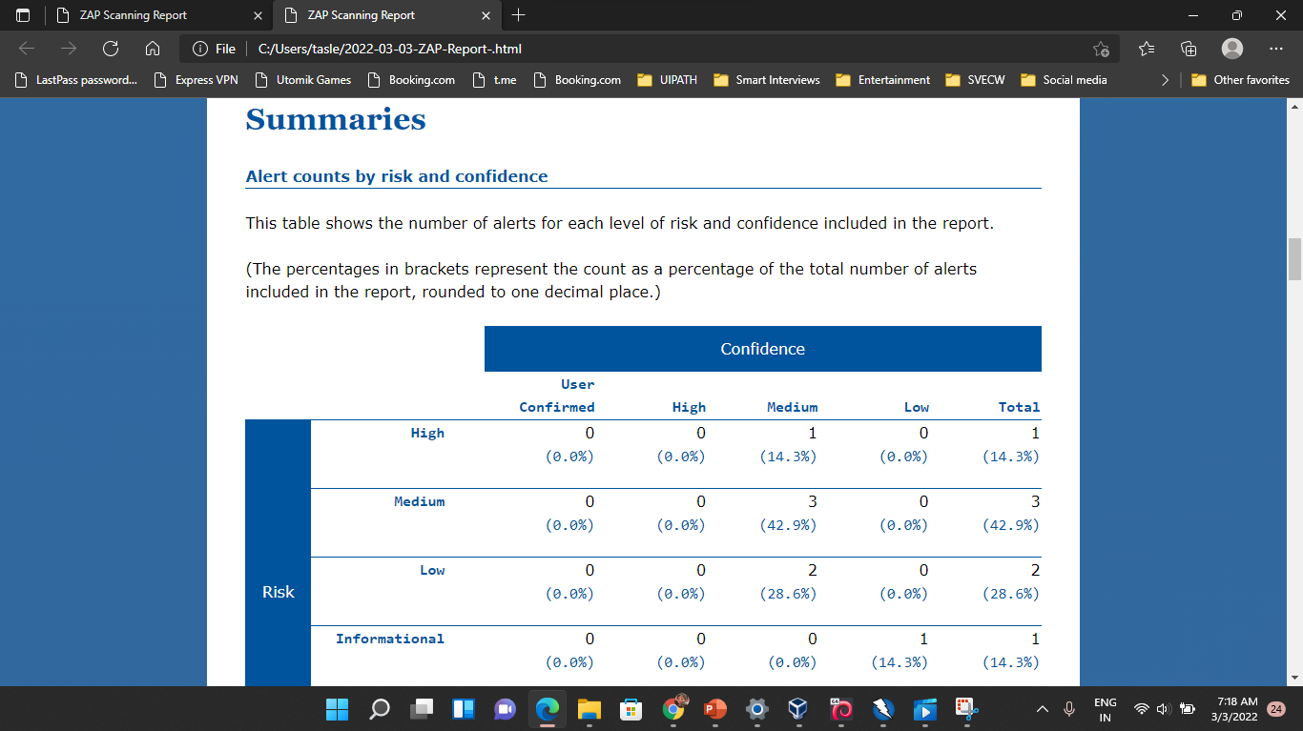

Slide 7
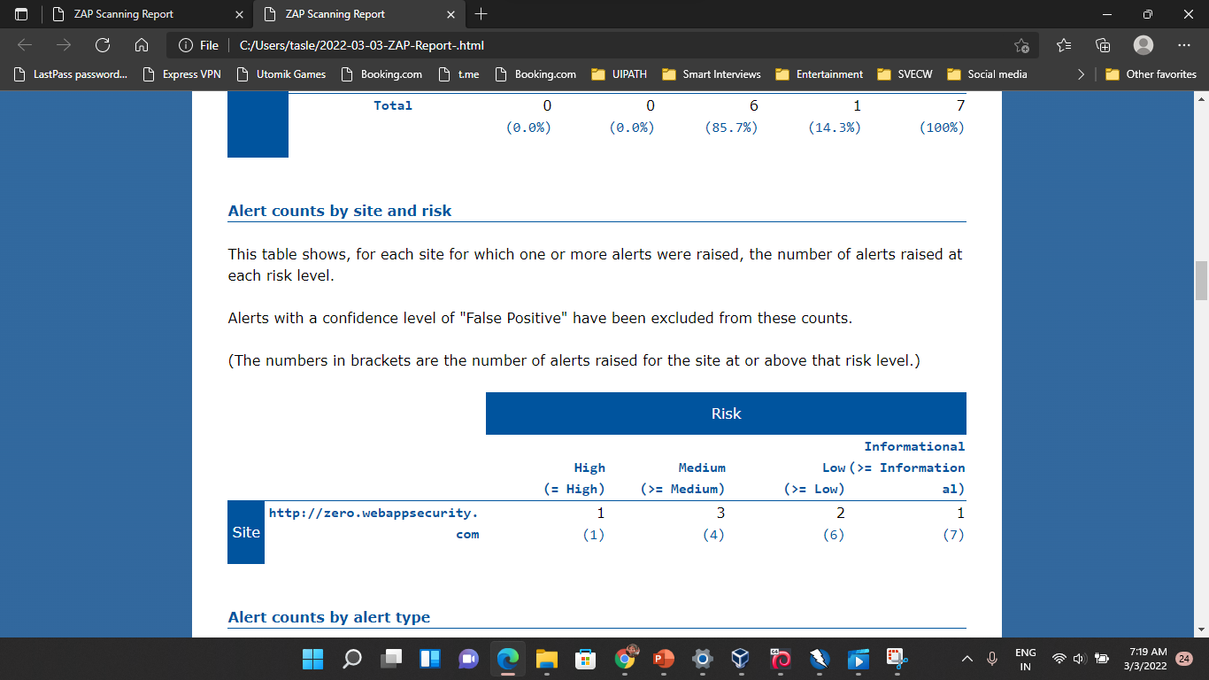

Slide 8
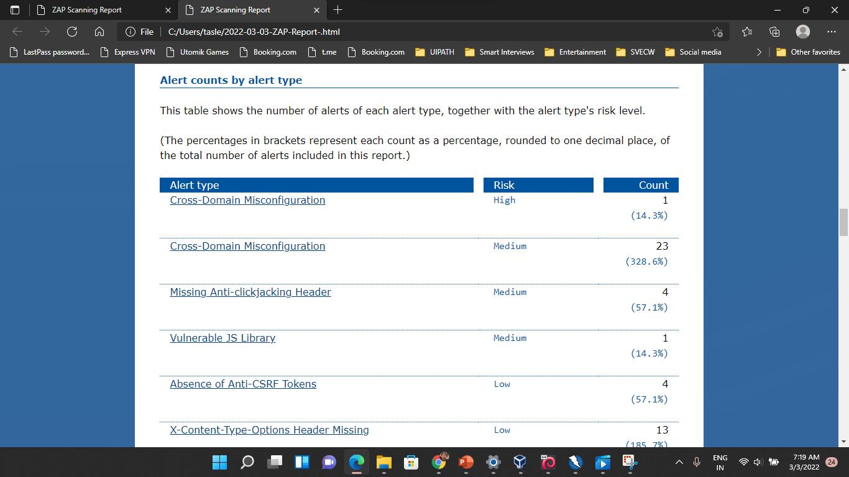

Slide 9
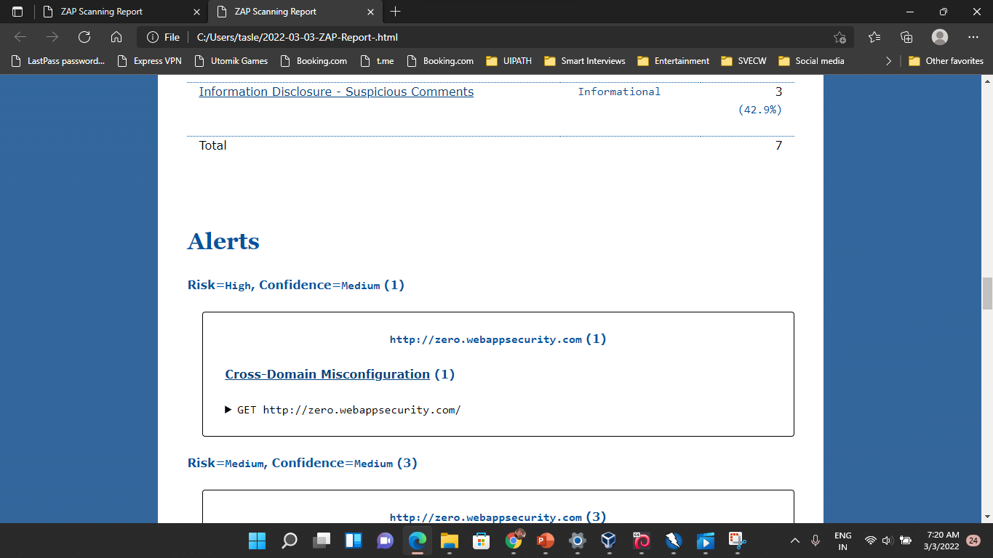

Slide 10
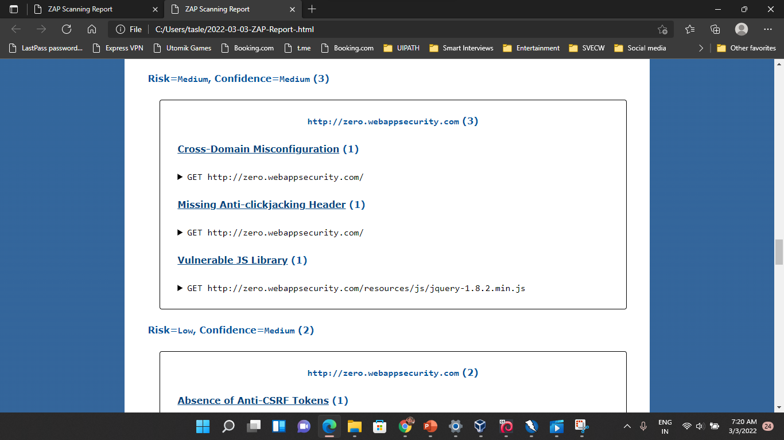

Slide 11
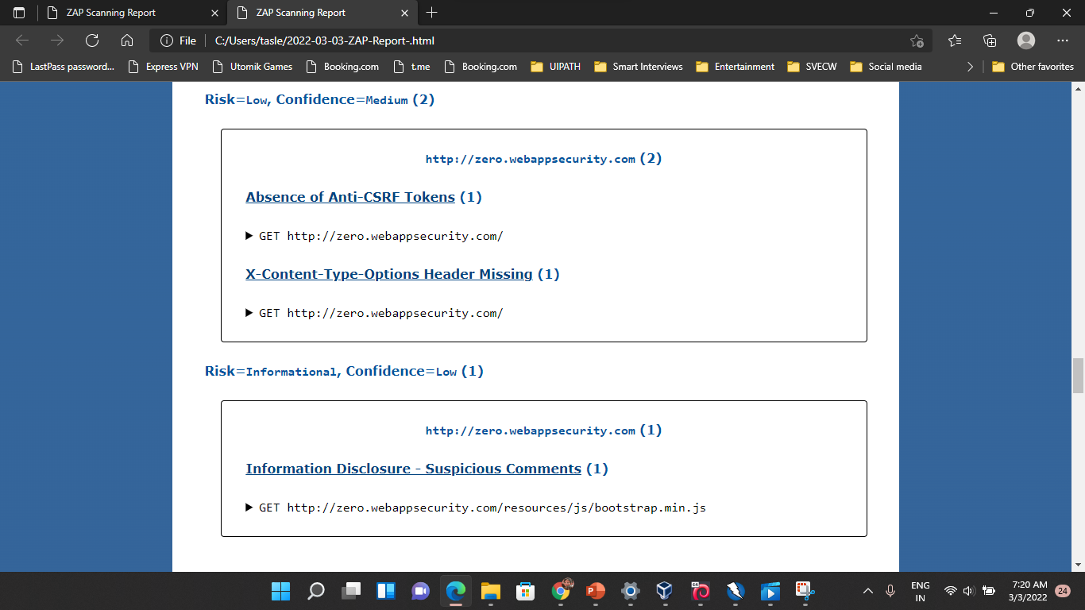

Slide 12
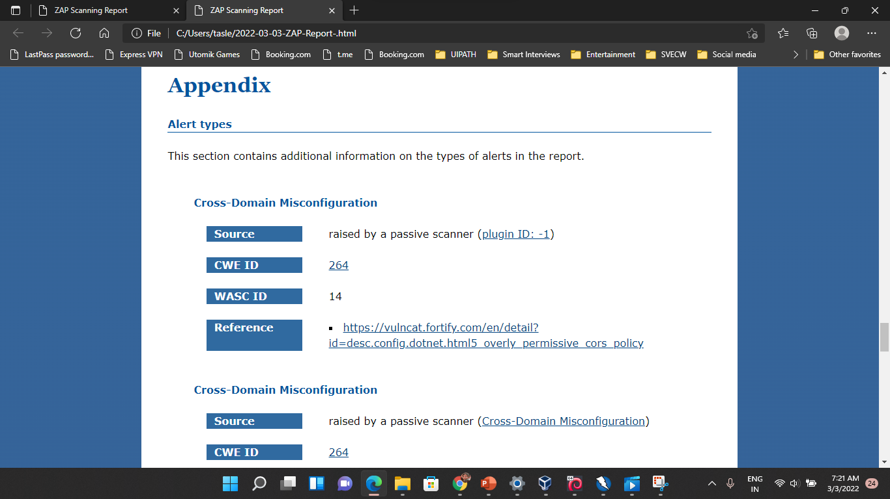

Slide 13
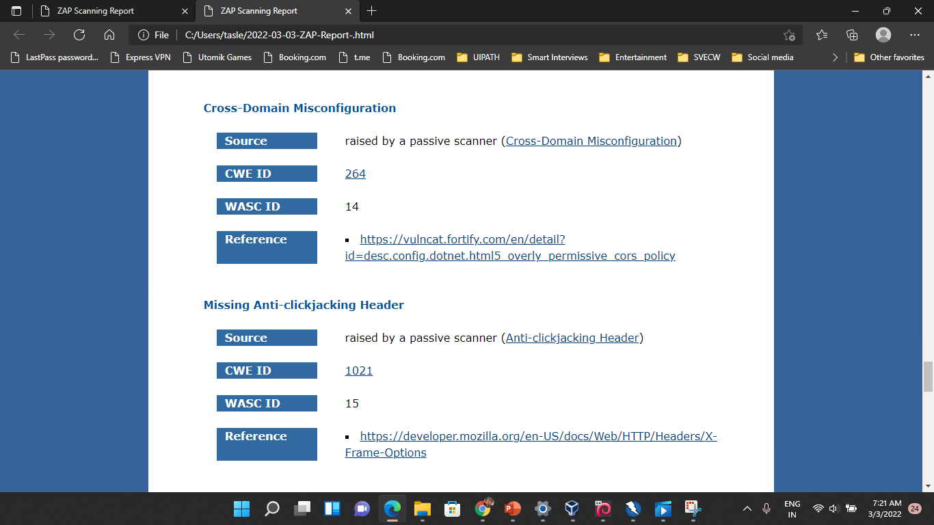

Slide 14
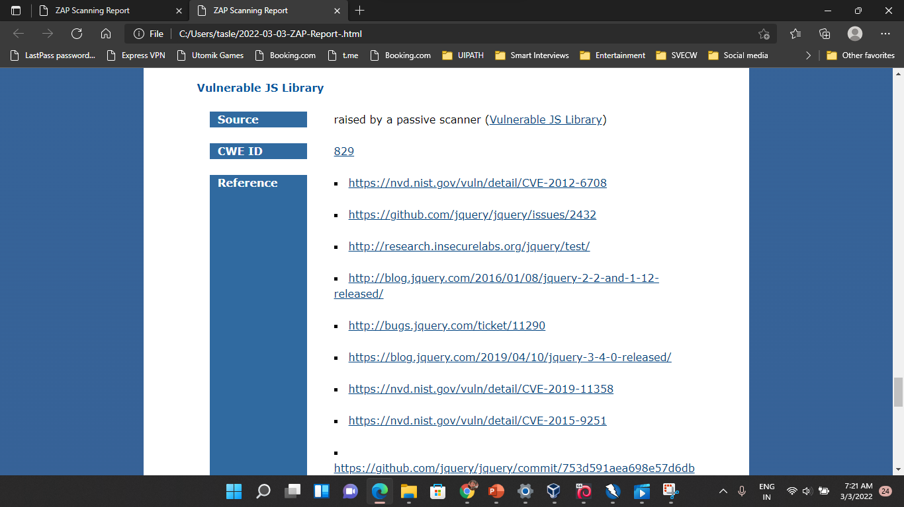

Slide 15
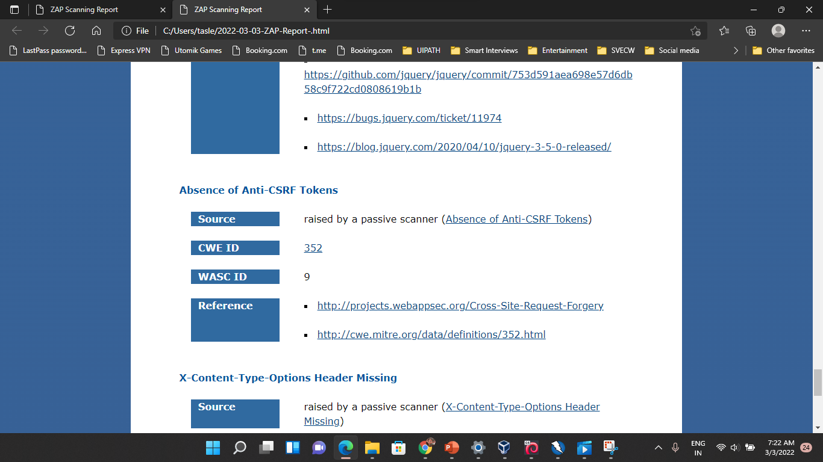

Slide 16
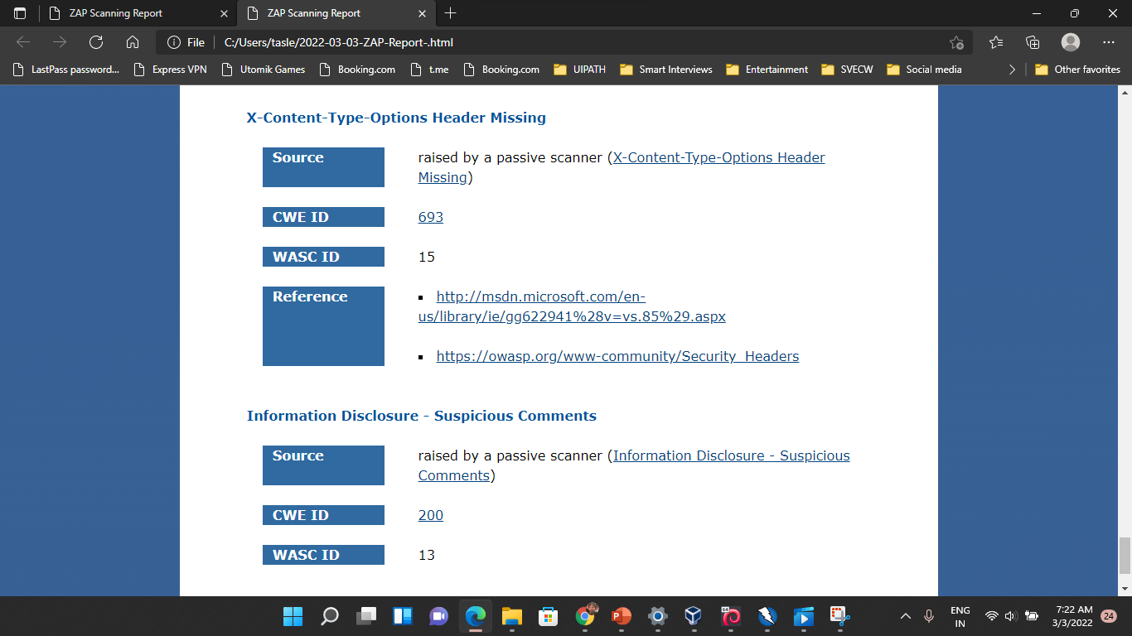

Slide 17
REPORT:
THERE ARE 4 TYPES OF VULNERABILITIES THEY ARE
1. HIGH RISK VULNERABILITIES
2. MEDIUM RISK VULNERABILITIES
3. LOW RISK VULNERABILITIES
4. INFORMATIONAL VULNERABILITIES
AFTER SCANNING THE GIVEN SITE THERE ARE TOTAL 13 VULNERABILITIES ,I HAVE TESTED IT IN ‘OWASP ZAP’ AUTOMATED SCAN

